Slide 1
House Sales in King County, USA
Chinara Orujova

Slide 2
Agenda
The purpose of this analysis
Overview the data set and data dictionary
Preprocessed the data set
Perform exploratory data analysis (EDA)
One Hot Encoding and standardization
Feature engineering
Build the different models
Making the prediction and evaluating the result

Slide 3
The purpose of this analysis
Predict the house price using regression
Find the pattern within the datasets

Slide 4
Overview the dataset and data dictionary
Dataset was consisting of 21613 observations and 21 features
Id - a notation for a house
Date - Date house was sold
Price - Price of the house
Bedrooms - Number of Bedrooms/House
Bathrooms - Number of bathrooms/House
sqft_living - square footage of the home
sqft_lot - square footage of the lot
floors - Total floors (levels) in house
waterfront - House which has a view to a waterfront
view - Has been viewed

Slide 5
Overview the dataset and data dictionary
condition - How good the condition is ( Overall )
grade - overall grade given to the housing unit, based on King County grading system
sqft_above - square footage of house apart from basement
sqft_basement - square footage of the basement
yr_built - Built Year
yr_renovated - Year when house was renovated
zipcode - zip
lat - Latitude coordinate
long - Longitude coordinate
sqft_living15 - Living room area in 2015(implies-- some renovations) This might or might not have affected the lot size area
sqft_lot15 – lot Size area in 2015(implies-- some renovations)

Slide 6
Preprocessed the dataset
During the preprocessing I did the following procedures:
Checked the data type – it was integer and float.
Dropped the ID and Date columns.
Checked the missing value – there was not any missing value
Checked the statistical information (mean, min, max, etc.). Min, max and mean on price was 75000, 7700000 and 540088 accordingly. Oldest house was built in 1900, newest one was built in 2015, and most of them built around 1971. Newest renovation was done on 2015. Zip code was between 98001 and 98199. Biggest sqft_living size was 13540, smallest size was 290, average size was 2079

Slide 7
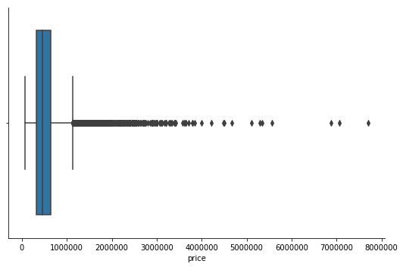
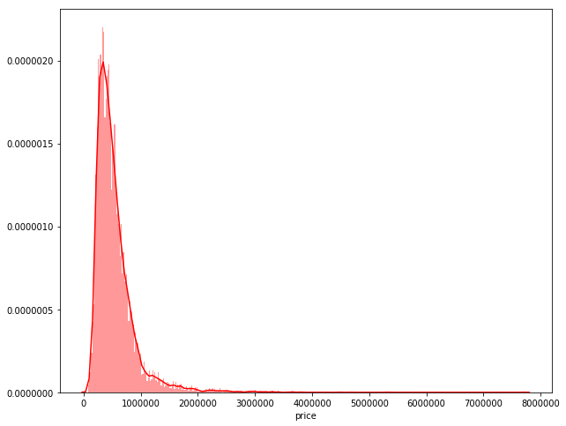
Perform exploratory data analysis (EDA)
I used the different visualization technique to show the individual feature or multiple features at the same time in order to see the relationship between them.
I visualized Price column using two different plots. Box plot help me to see the median, min, max numbers as well as the outliers.

Slide 8
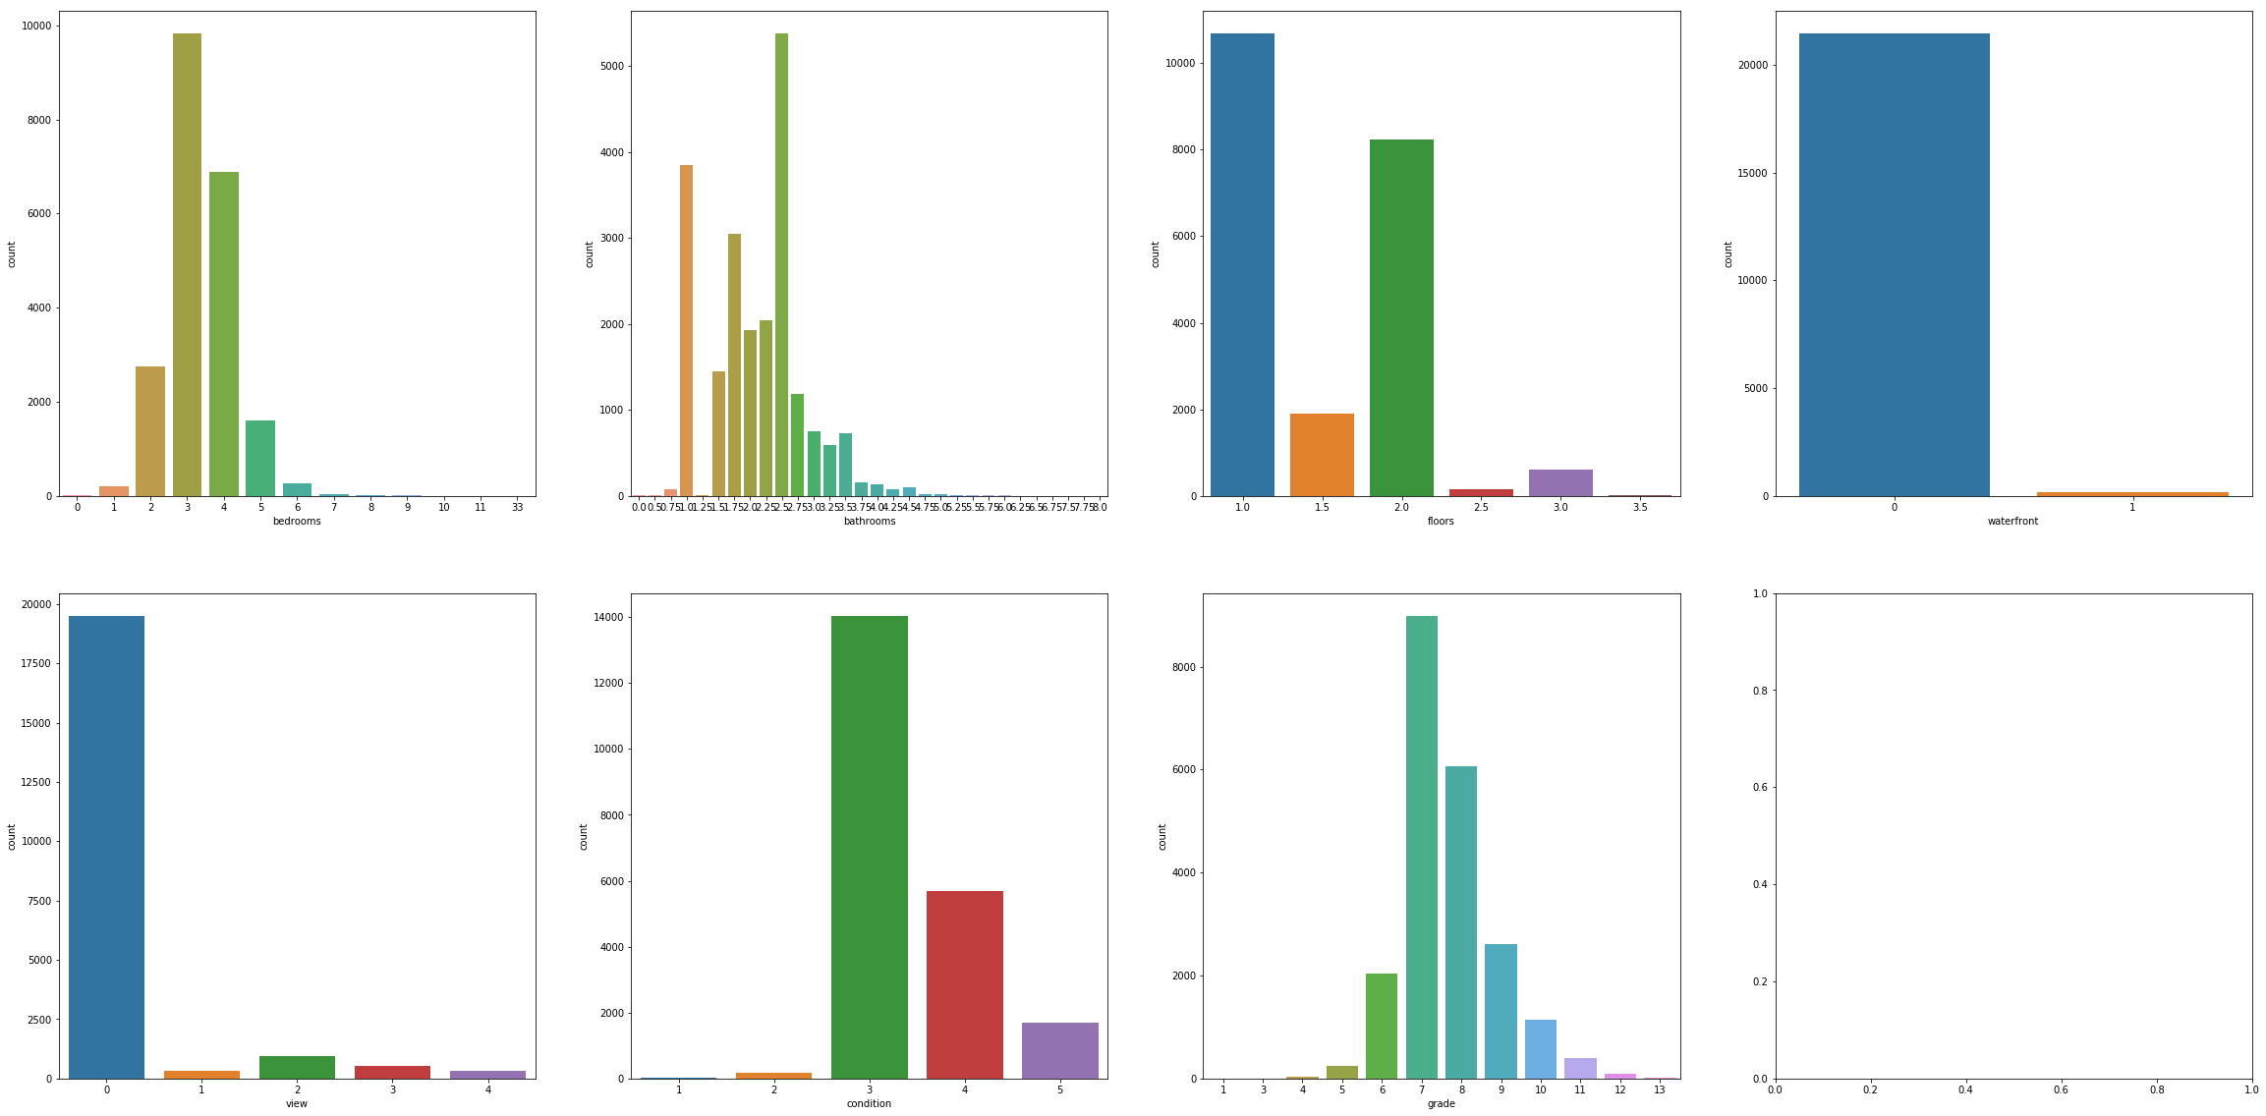
EDA – feature visualization
I used the subplot to visualize some features at the same time and then got the percentage each of these features’ levels. Most of the houses have 3 bedrooms (0.45%), 2.5 bathrooms (0.24%) and 1 floor (0.49%). 0.99% of houses did not have a view to a waterfront, 0.90% houses were viewed 0 time, 0.64% of houses condition was 3 which is medium, 0.41% of house got the 7 grade which was medium as well.

Slide 9
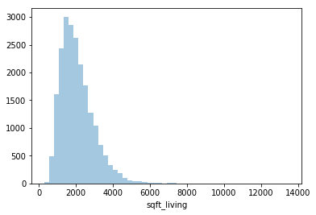
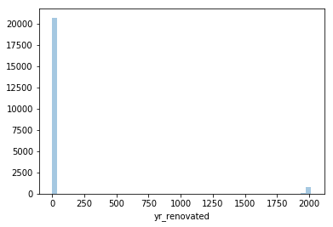
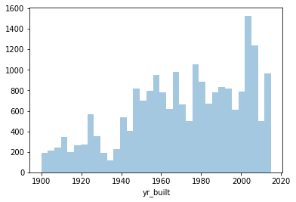
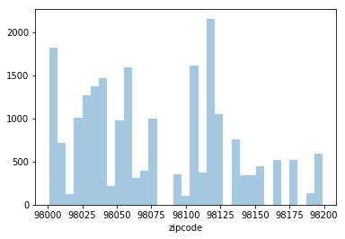
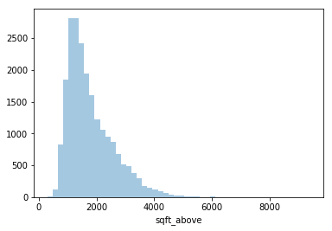
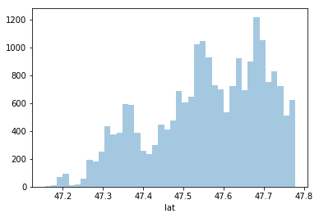
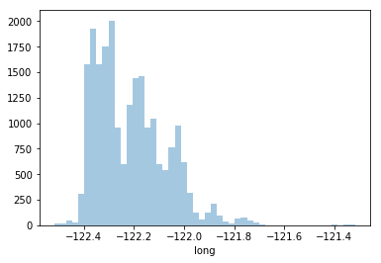
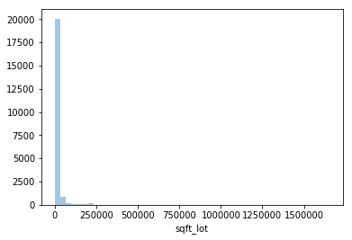
EDA – feature visualization
Distribution on sqft_above and sqft_living was very similar.
A lot of houses were built after 2000.
Most majority of houses did not have renovation. Few of them renovated around 2000.

Slide 10
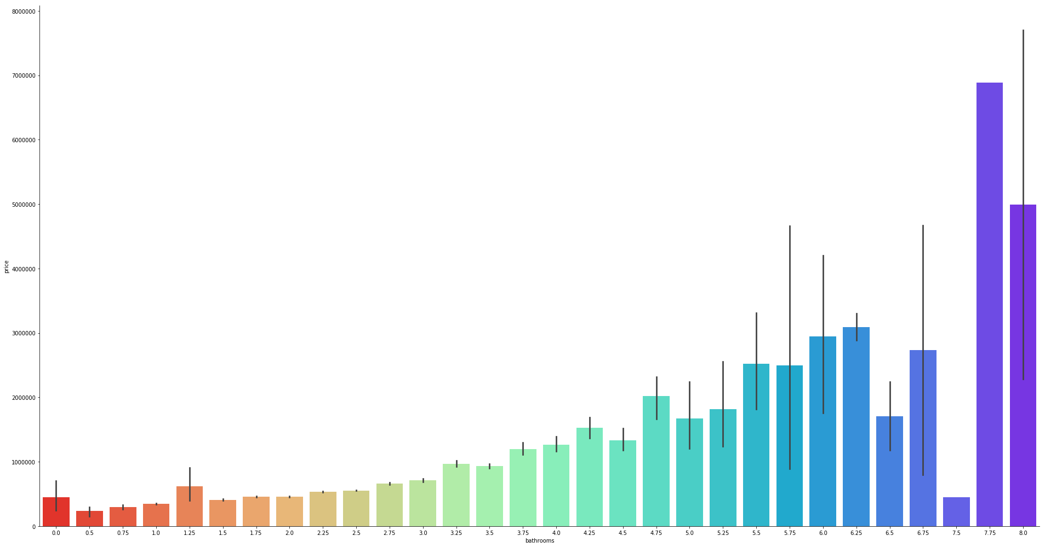
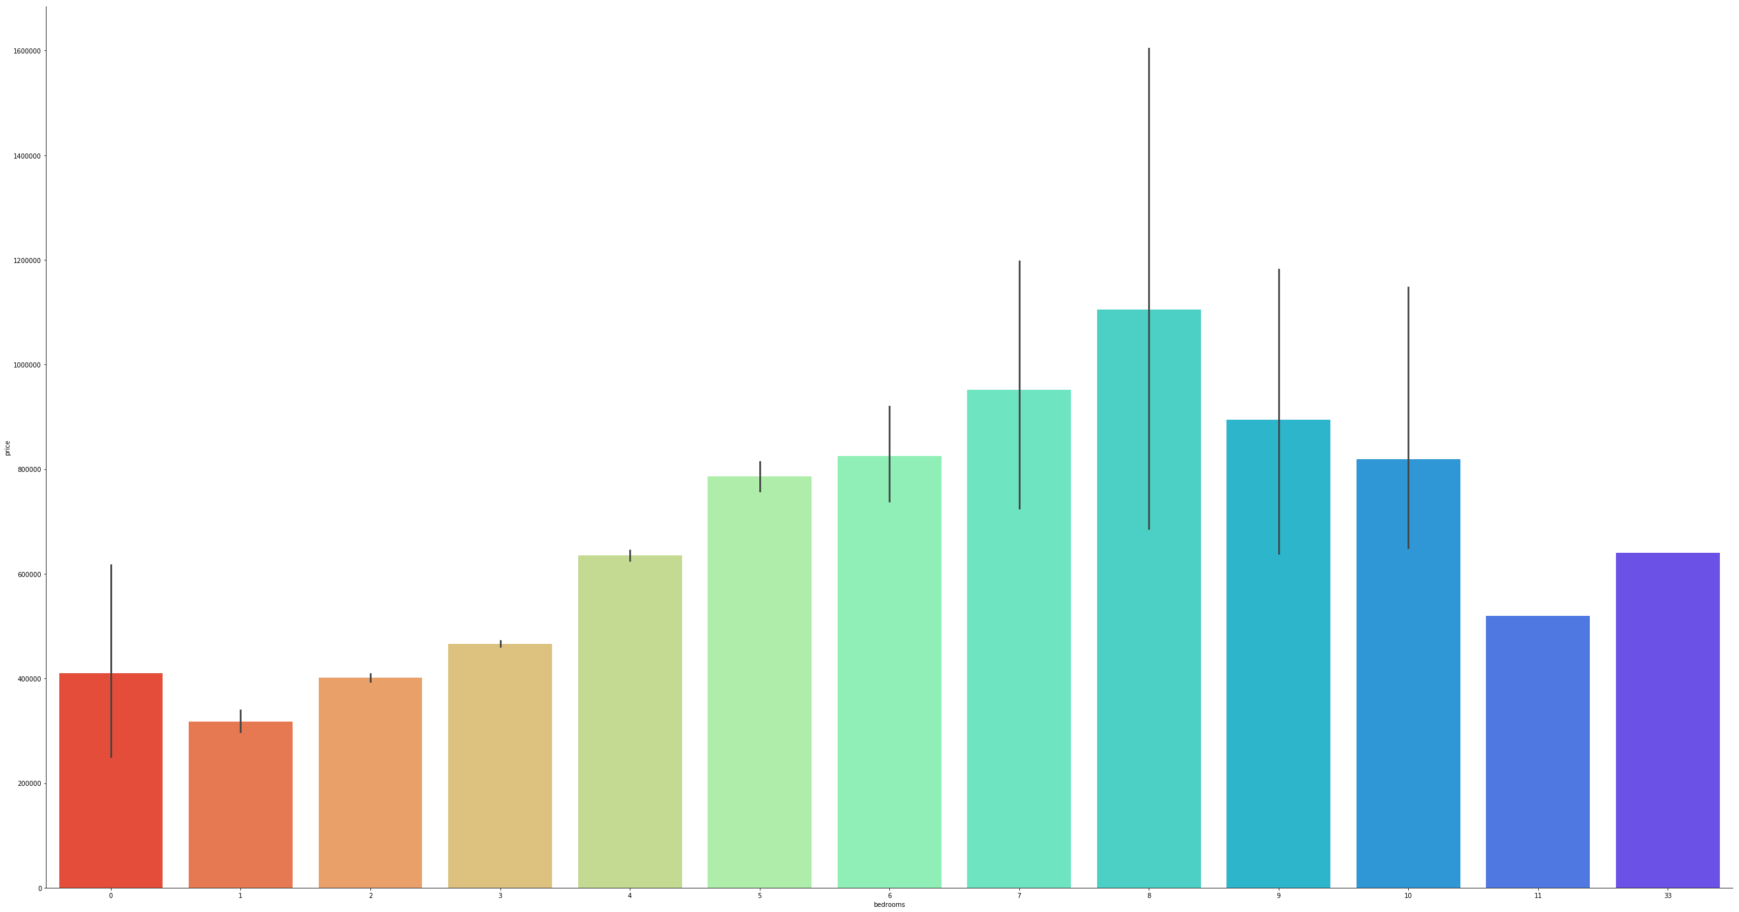
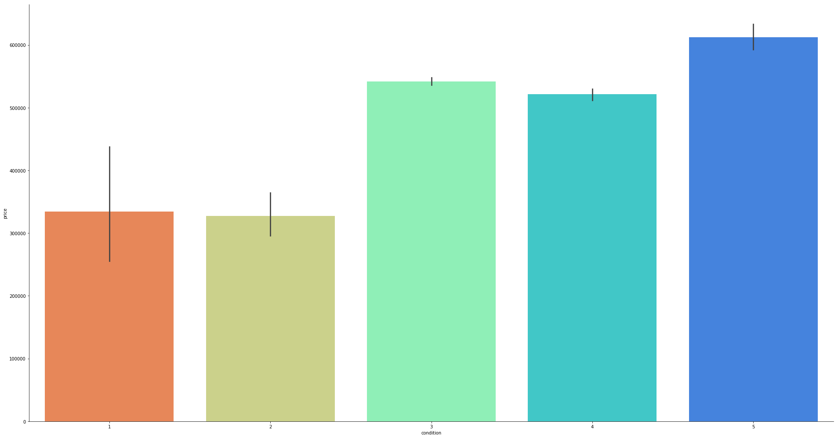
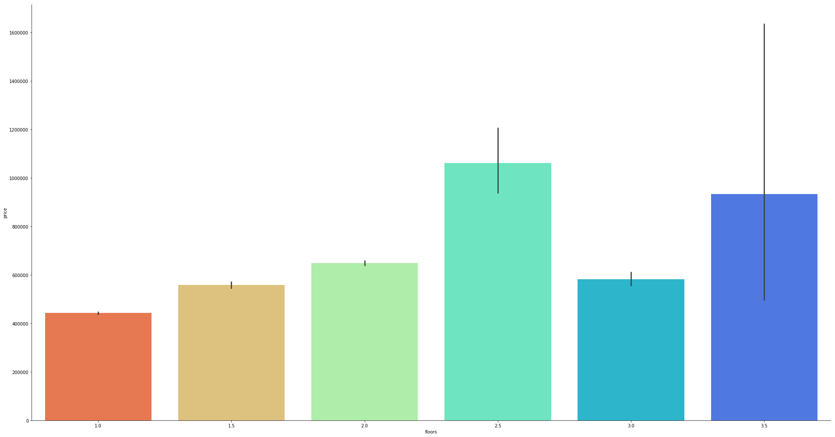
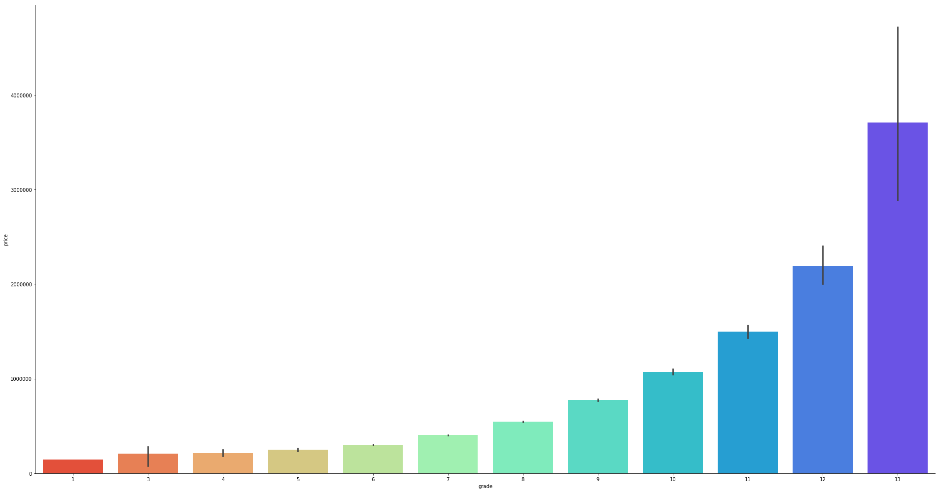
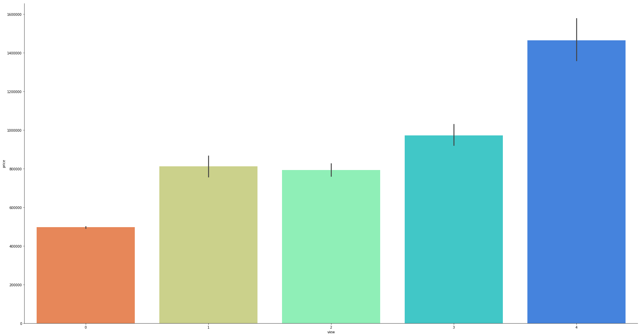
EDA – feature visualization
I used the factorplot to see the features relationship with price. The houses price increased when houses had 8 bedrooms and bathrooms, when they had view to a waterfront, had 2.5 floors and had the highest number of view (4), condition (5) and grade(13).

Slide 11
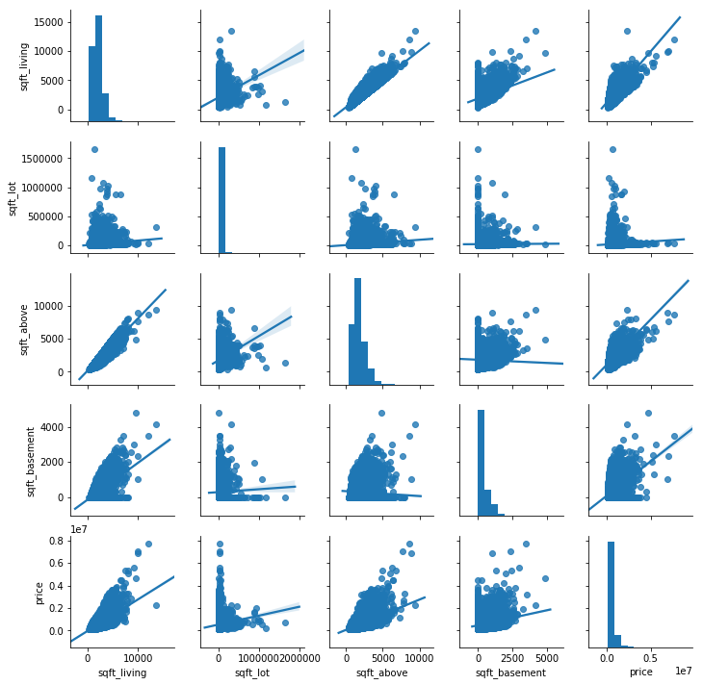
EDA – feature visualization
The pairs plot gave me very valuable insights. I used the numerical attributes for this plot. The histogram on the diagonal shows the distribution of a single variable while the scatter plots on the upper and lower triangles show the relationship between two variables. From the plot we can see very high correlation between sqft_living and sqft_above. There is also good correlation between sqft_living and price.

Slide 12
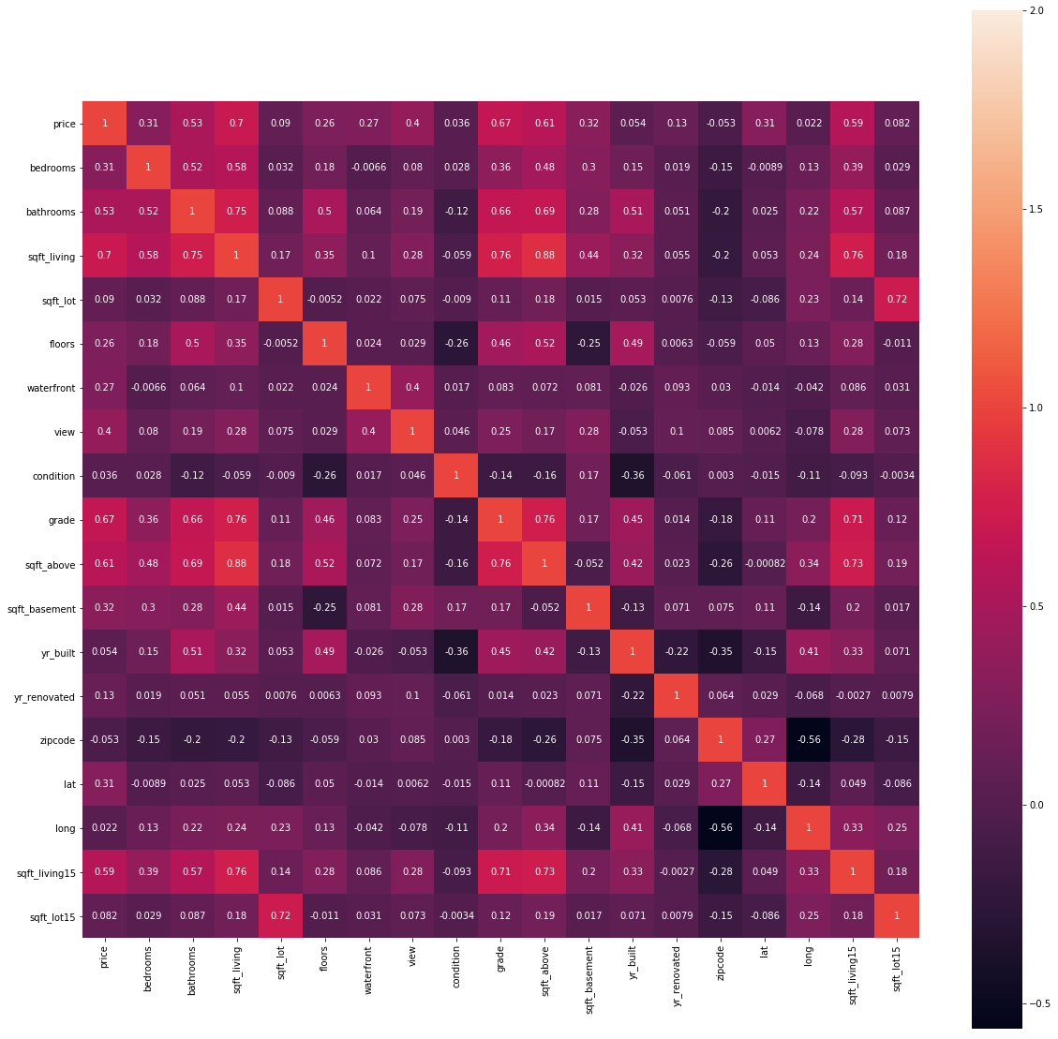
EDA – correlation
I used the heat map to see how strong the relationship between the features was. I found out that correlation between sqft_living and sqft_above was really high, which can cause overfitted data, thus I deleted sqft_above attribute from dataset.

Slide 13
One Hot Encoding and standardization
Before building the models I did some preprocessing again using the Scikit learn library’s functions.
I put the different scaled features into same scale. It help the models to compare features and give more accurate result. Following features were standardized:
price, sqft_lot, sqft_living, sqft_basement, lat, long, sqft_lot15, sqft_living15
I converted categorical features into numerical data using the One Hot encoding. After this procedure features number was increased from 18 to 38. Following features were converted:
waterfront, view, condition, grade

Slide 14
Build the different models
I divided dataset into 4 areas: X_train, y_train, X_test, y_test
I used Cross Validation to assess the predictive performance of the models and judge how they perform in test data.
I build 3 regression models and tuned their parameters:
RandomForestRegressor
LinearRegression
KNeighborsRegressor

Slide 15
Build the different models
In regression analysis I need to find the lowest level of error and the highest R-Squared. After run the model I got following result:
Random Forest Regressor gave the highest R squared but it can cause overfitted data, thus I chose Linear Regression model as best fitted model which gave me second highest number of R squared in trained data set. It gave me high R squared and low error rate in test data set as well.
Models | R squared
Random Forest Regressor | 0.979
KNeighborsRegressor | 0.726
Linear Regression | 0.736
Models | Predicted R squared | Predicted RMSE
Random Forest Regressor | 0.836 | 0.367
KNeighborsRegressor | 0.595 | 0.577
Linear Regression | 0.705 | 0.492

Slide 16
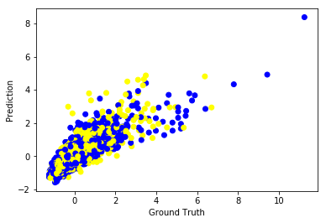
Model evaluation
After run the models and chose best fitted one, I used the plot to evaluate the prediction with ground trust (y_test).
It seems that the prediction is correlated with the true price, though there clearly some biases.

Slide 17
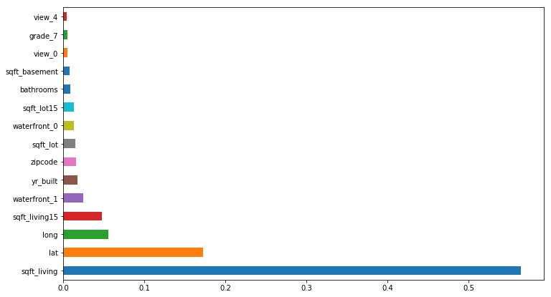
Feature engineering
I used the plot to show the most important features in dataset. It shows that sqft_living, lat, long, sqft_living15 and waterfront_1 were 5 most important features.
I used the PCA and feature selection for dimensionality reduction.
PCA combines similar attributes and creates new 7 columns. (n_components=7). I trained the Linear Regressor on the transformed output, i.e. using only new created features. I got lower R squared than I got from original data set. (R squared – 0.551)
In Feature Selection method features are considering unimportant and removed , if the value are below the provided threshold parameter (threshold =median). This function decrease the features number from 37 to 19. I trained the Linear Regressor on the transformed output, i.e. using only relevant features. I got the lower R squared than the original data set. (R squared – 0.697)

